Slide 1
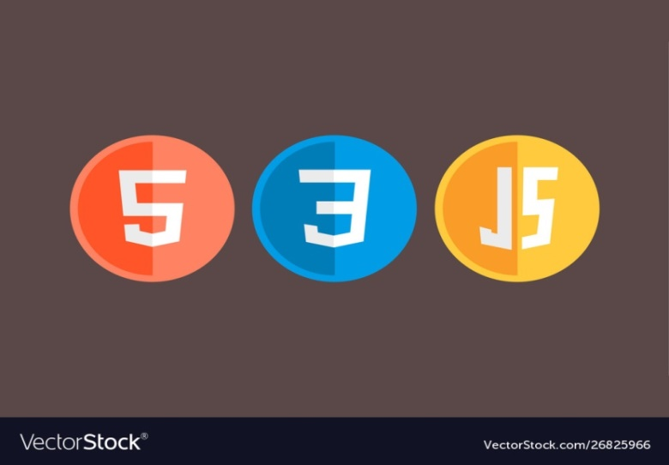
INDERPRASTHA ENGINEERING COLLEGE
MINI PROJECT PRESENTATION
ON
FRONTEND WEB DEVELOPMENT
Harshit Chaudhary(2000300100106)
Hritik Chaturvedi (2000300100114)

Slide 2
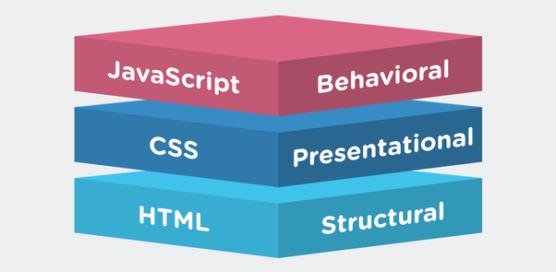
THREE LAYERS OF WEB DESIGN

Slide 3
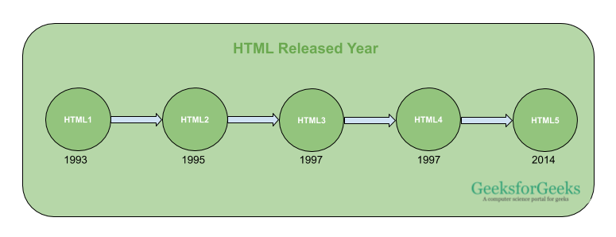
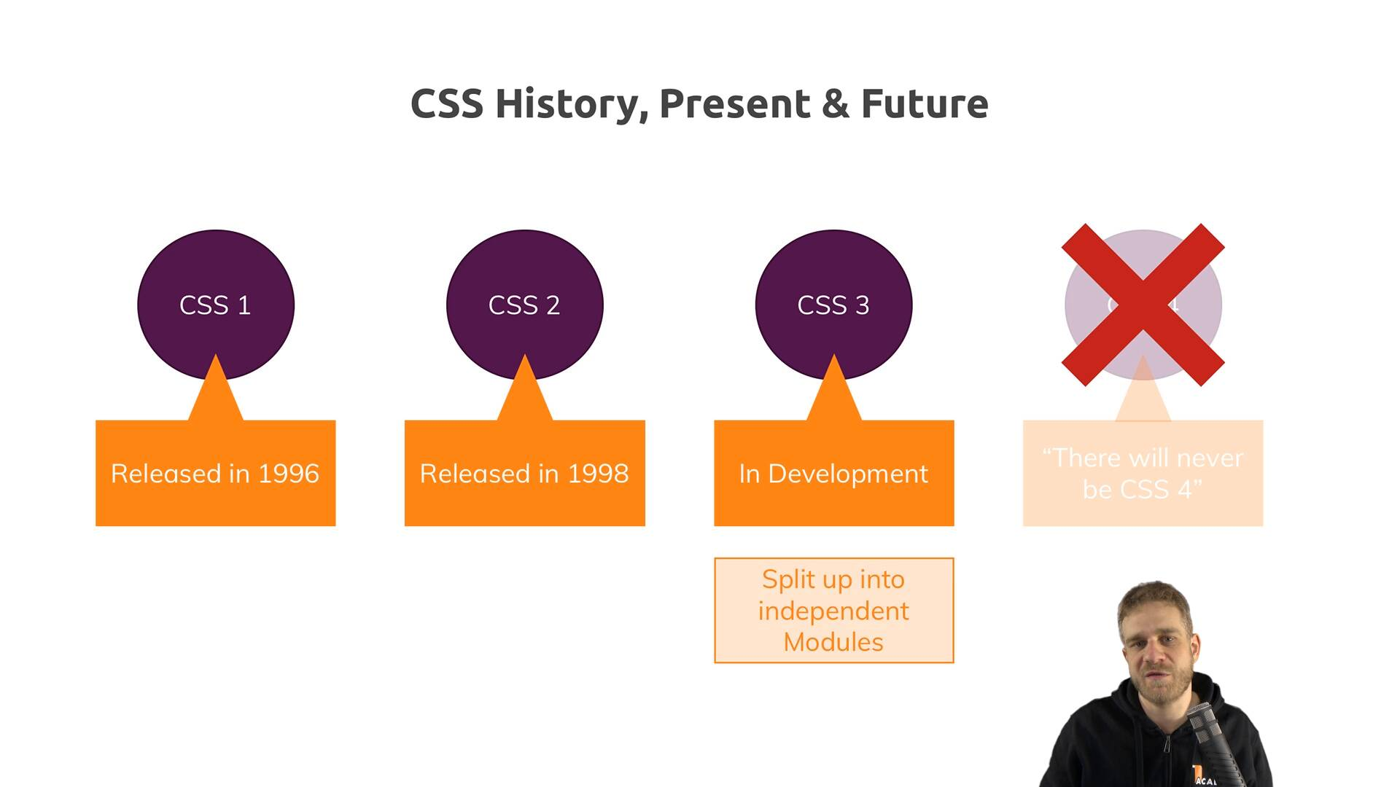
BRIEF HISTORY OF HTML AND CSS

Slide 4
HTML
HTML stands for Hyper Text Markup Language. It is used to design web pages using a markup language. HTML is the combination of Hypertext and Markup language. Hypertext defines the link between the web pages. A markup language is used to define the text document within tag which defines the structure of web pages.
HTML is a markup language that is used by the browser to manipulate text, images, and other content to display in the required format.

Slide 5
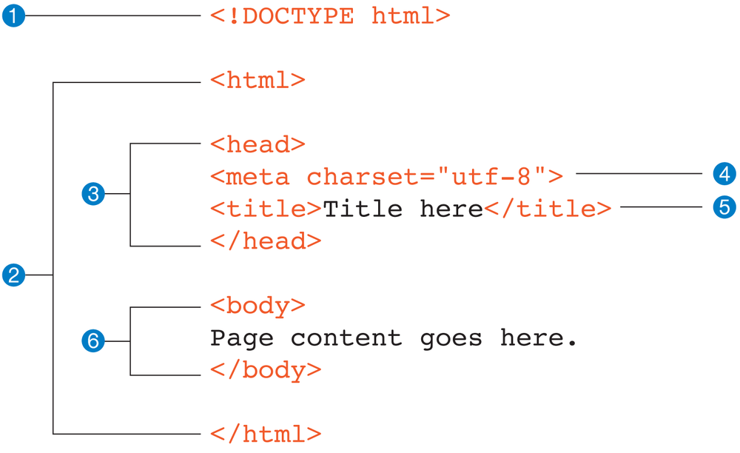
HTML PAGE STRUCTURE

Slide 6
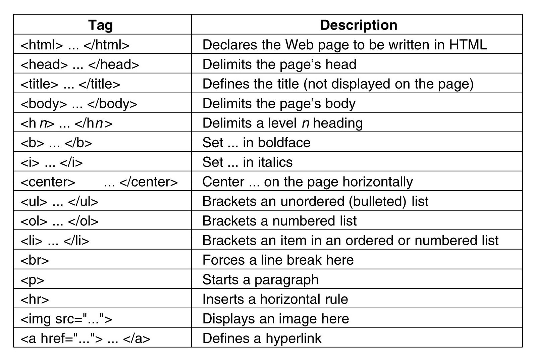
SOME TAGS USED

Slide 7
CSS
CASCADING STYLE SHEETS
Cascading: It refers to the procedure that determines which style will apply to certain section ,if you have more than one style rule.
Style: How you want a certain part of your page to look. You can set things like color, margins, fonts, padding etc.
Sheets: It is like a templates or a set of rules, for determining how webpages will look.
CSS is a style sheet language used to describe the presentation written in HTML.

Slide 8
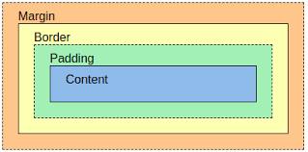
CSS BOX MODEL

Slide 9
TYPES OF CSS
Inline CSS: Inline CSS contains the CSS property in the body section attached with element is known as inline CSS. This kind of style is specified within an HTML tag using the style attribute.
Internal or Embedded CSS: This can be used when a single HTML document must be styled uniquely. The CSS rule set should be within the HTML file in the head section i.e the CSS is embedded within the HTML file.
External CSS: External CSS contains separate CSS file which contains only style property with the help of tag attributes (For example class, id, heading, … etc). CSS property written in a separate file with .css extension and should be linked to the HTML document using link tag. This means that for each element, style can be set only once and that will be applied across web pages.

Slide 10
SELECTORS IN CSS
CSS class Selector
The class selector selects HTML elements with a specific class attribute.To select elements with a specific class, write a period (.) character, followed by the class name.
CSS id Selector
The id selector uses the id attribute of an HTML element to select a specific element.The id of an element is unique within a page, so the id selector is used to select one unique element!To select an element with a specific id, write a hash (#) character, followed by the id of the element.
CSS Universal Selector
The universal selector (*) selects all HTML elements on the page.
CSS Grouping Selector
The grouping selector selects all the HTML elements with the same style definitions.

Slide 11


IMPORTANCE OF CSS
WITH CSS
WITHOUT CSS

Slide 12

JAVASCRIPT
JavaScript is a lightweight, cross-platform, and interpreted scripting language. It is well-known for the development of web pages, many non-browser environments also use it. JavaScript can be used for Client-side developments as well as Server-side developments. JavaScript contains a standard library of objects, like Array, Date, and Math, and a core set of language elements like operators, control structures, and statements.

Slide 13
TYPES OF JSS
Internal JS: We can add JavaScript directly to our HTML file by writing the code inside the <script> tag. The <script> tag can either be placed inside the <head> or the <body> tag according to the requirement.
External JS: We can write JavaScript code in other file having an extension .js and then link this file inside the <head> tag of the HTML file in which we want to add this code.
SYNTAX :-
<script>
// JavaScript Code
</script>

Slide 14
JAVASCRIPT
APPLICATION
FRAMEWORK
Client side validation
Manipulating HTML Pages
Back-end Data Loading
Server Applications
Presentations
Angular
React
jQuery
Vue.js
Ext.js
Ember.js
Meteor
Node.js
Polymer

Slide 15
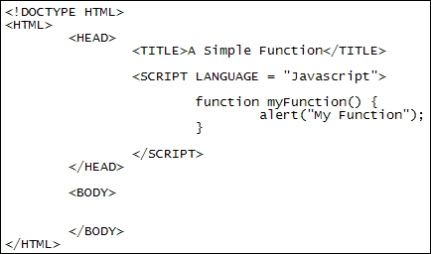
STRUCTURE OF JAVASCRIPT CODE

Slide 16
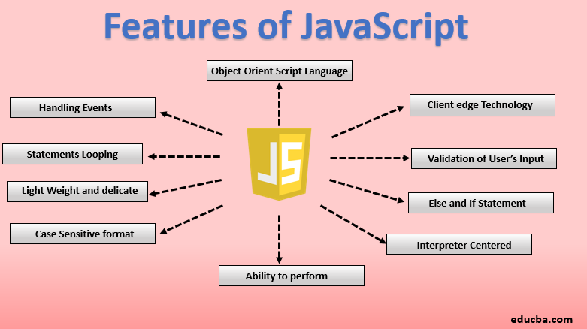
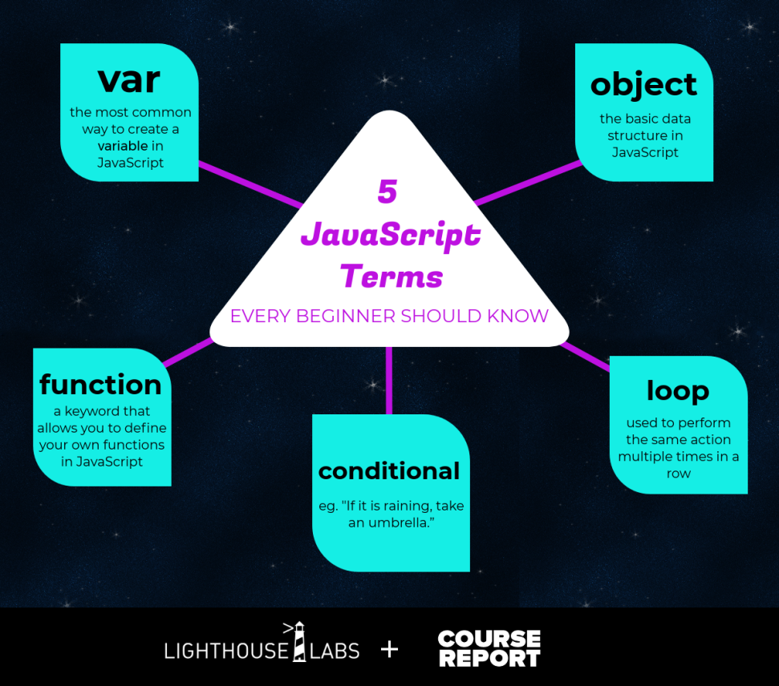
FEATURES & TERMS OF JS

Slide 17
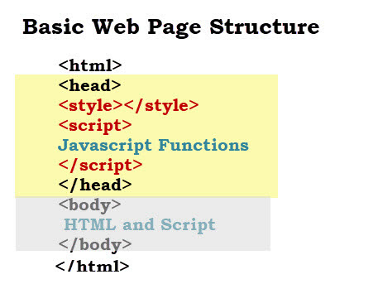
BASIC WEB PAGE

Slide 18
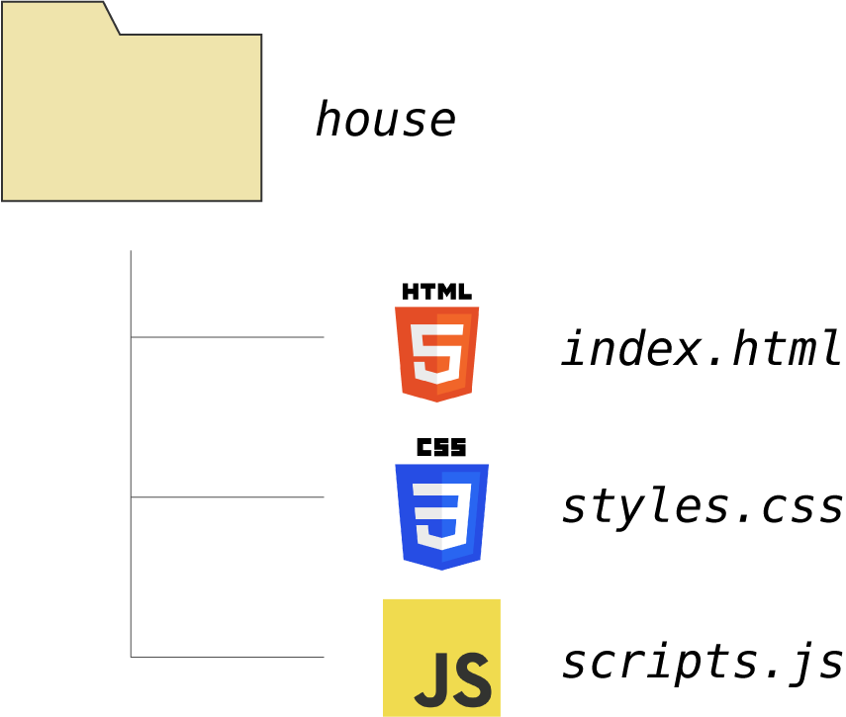
USEDEXTENSION

Slide 19
REFERENCES
https://www.udemy.com/
https://www.geeksforgeeks.org/
https://www.w3schools.com/

Slide 20
THANK
YOU

